Slide 1
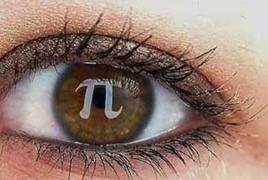
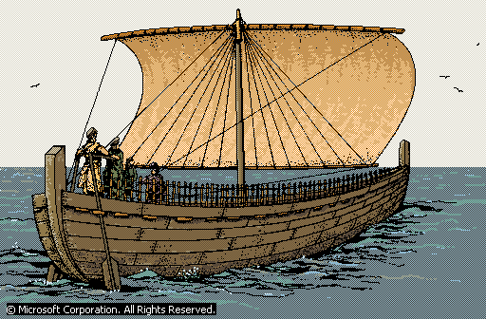

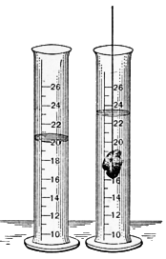




2.3….ARCHIMEDES’ PRINCIPLE

Slide 2
The law
Archimedes' Principle, law of physics that states that when an object is totally or partially immersed in a fluid, it experiences an upthrust equal to the weight of the fluid displaced.
The principle is most frequently applied to the behaviour of objects in water, and helps to explain floating and sinking, and why objects seem lighter in water. It also applies to balloons in the air.

Slide 3
Archimedes Principle
Archimedes’ Principle
An object completely immersed in a fluid experiences an upward buoyant force equal in magnitude to the weight of fluid displaced by the object.

Slide 4
Density and Buoyancy
From Archimedes’s Principle :
Buoyant Force = Weight of fluid displaced
= mg (note : F = ma)
= ρVg (note : ρ = m )
V
Thus F_{B} = ρ V g
Where ……
F_{B} = Buoyant Force or Upthrust
ρ = Density of fluid
V = Volume of fluid displaced or
the volume of the object that immersed in the fluid.

Slide 5
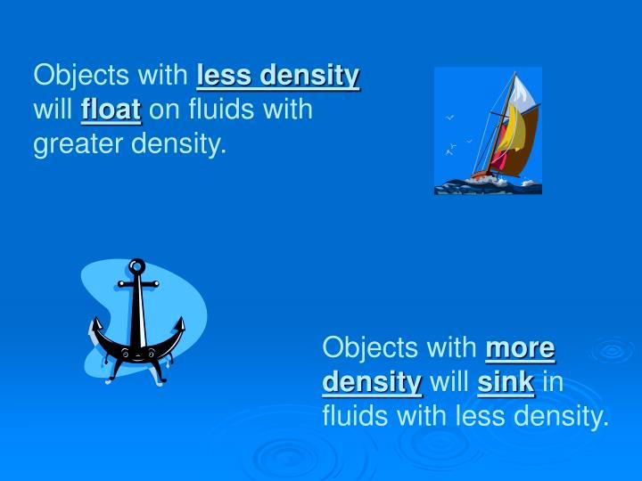

Slide 6


Slide 7
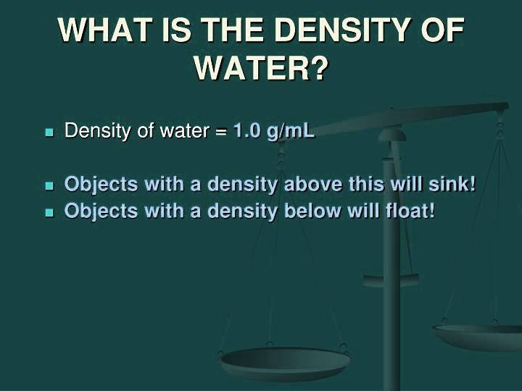

Slide 8
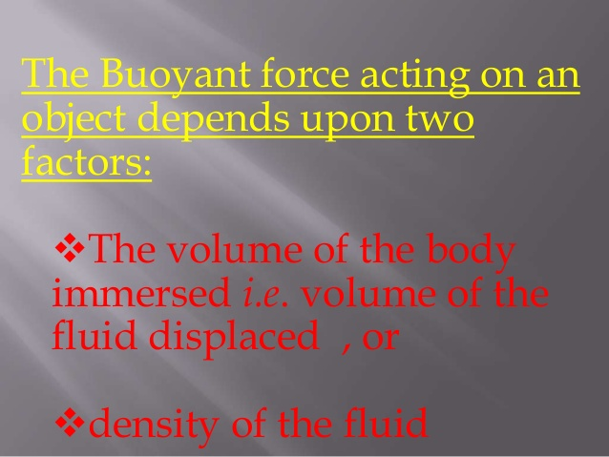

Slide 9
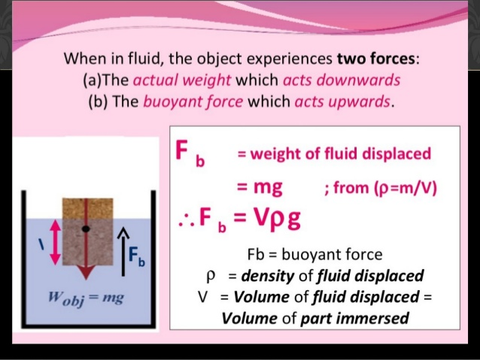

Slide 10
h₂
Buoyant Force When a Volume V is Submerged in a Fluid of Density ρfluid
B
h₁
E
C
Fb = ρfluid gV
D
At point C the pressure is (P1)
F₁=P₁A=ρgh₁A
Where ρ is density of liquid
At point B the pressure (P2)
F₂=P₂A=ρgh₂A

Slide 11
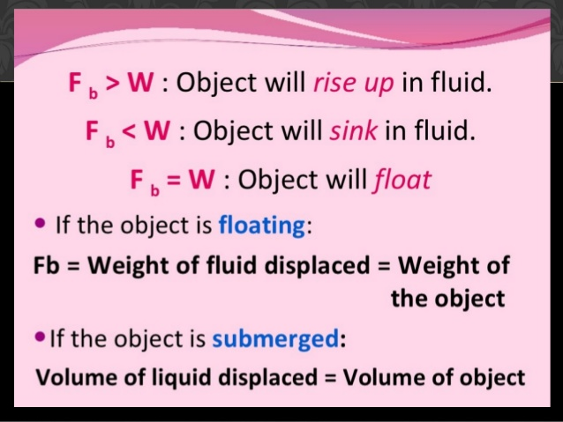

Slide 12
The total net forces are:
ΔF=F₁-F₂=ρgh₁A-ρgh₂A=(h₁-h₂)ρgA
But the volume of body :
V=(h₁-h₂)A
ΔF=Vρg
m=ρV
ΔF=mg
Buoyant Force = Weight of fluid displaced

Slide 13
Buoyancy F_{b} F_{b}=m_{ld} . g
where ld : liquid being displaced
Body’s weight W W= m_{b}.g
b: body
floating sinking
F_{b}=W F_{b}< W
m_{ld}.g = m_{b} .g m_{ld}.g < m_{b} . g
ρ_{ld} V_{ld} = ρb . V_{b} ρ_{ld} < ρ_{b}
as V_{ld}< V_{b}
ρ_{ld} > ρ_{b} ρ_{ld} < ρ_{b}

Slide 14
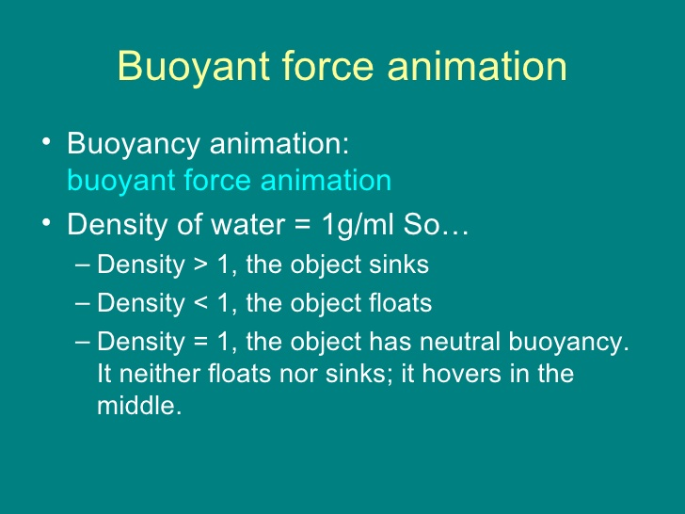

Slide 15
Example
1. The weight of the rock in air is 0.85N. When it is completely submerged in water, its weight is 0.45N. What is the buoyant force acting on the rock when it is completely submerged in the water ?
Solution :
Buoyant force = Actual weight – Apparent weight
= 0.85 – 0.45
= 0.4N

Slide 16
When an object is submerged in a fluid, there is a buoyant force. An object of 7N weigh submerged in a fluid is hanged by a rope, which has a tension of 5 N. What is the buoyant force?
Clicker!
5N
F_{B}
(1) 1 N downward (2) 1 N upward (3) 2 N downward
(4) 2 N upward (5) 5 N downward (6) 5 N upward
(7) 12 N downward (8) 12 N upward
7N
Just another force
Σ F_{Y} = 0
5N – 7N + F_{B} = 0
F_{B} = 7N – 5N

Slide 17
Floating versus Completely Submerged
F_{B}
Floating:
F_{B} = W V_{DISPLACED}< V_{OBJECT}
ρ_{OBJ} < ρ_{FLUID}
F_{B} = ρ_{FLUID} V_{DISPLACED} g
W = ρ_{OBJ} V_{OBJECT} g
Completely Submerged
V_{DISPLACED}=V_{OBJECT}
F_{B} = ρ g V_{OBJECT}
F_{G}
ρ_{OBJ} > ρ_{FLUID}

Slide 18
Object B is larger than A. If we put both objects into water, which of the following statement is true?
Clicker!
(1) Both A, and B will immerse into water.
(2) A will completely immerse, B will float.
(3) B will completely immerse, A will float. (4) Both will float. (5) None of the above is correct.
A
2000 kg/m^3
B
500 kg/m^3
Density of A > density of water
Density of B < density of water

Slide 19
Example 4: If ice has a density of 920 kg/m³, what percentage of an iceberg sticks out above the waterline? If the mass of the ice is 20 kg, what is the volume of the ice that is sticking out of water?
F_{BUOYANT} = Weight
ρ_{w} g V_{DISPLACED} = ρ_{ICE} g V_{ICE}
ρ_{w} g V_{SUBMERGED} = ρ_{ICE} g V_{ICE}
V_{SUB} / V_{OBJ} = ρ_{ICE} / ρ_{w}
V_{SUB} / V_{OBJ} = 0.92
So fraction not submerged is 1-0.92 or 0.08, 8%

Slide 20
An object of mass 1500 kg with a density of 2000 kg/m³ is put into water. (a) Will this object float? (b) What will be the weight of the object in water?
Example 5

